Slide 1
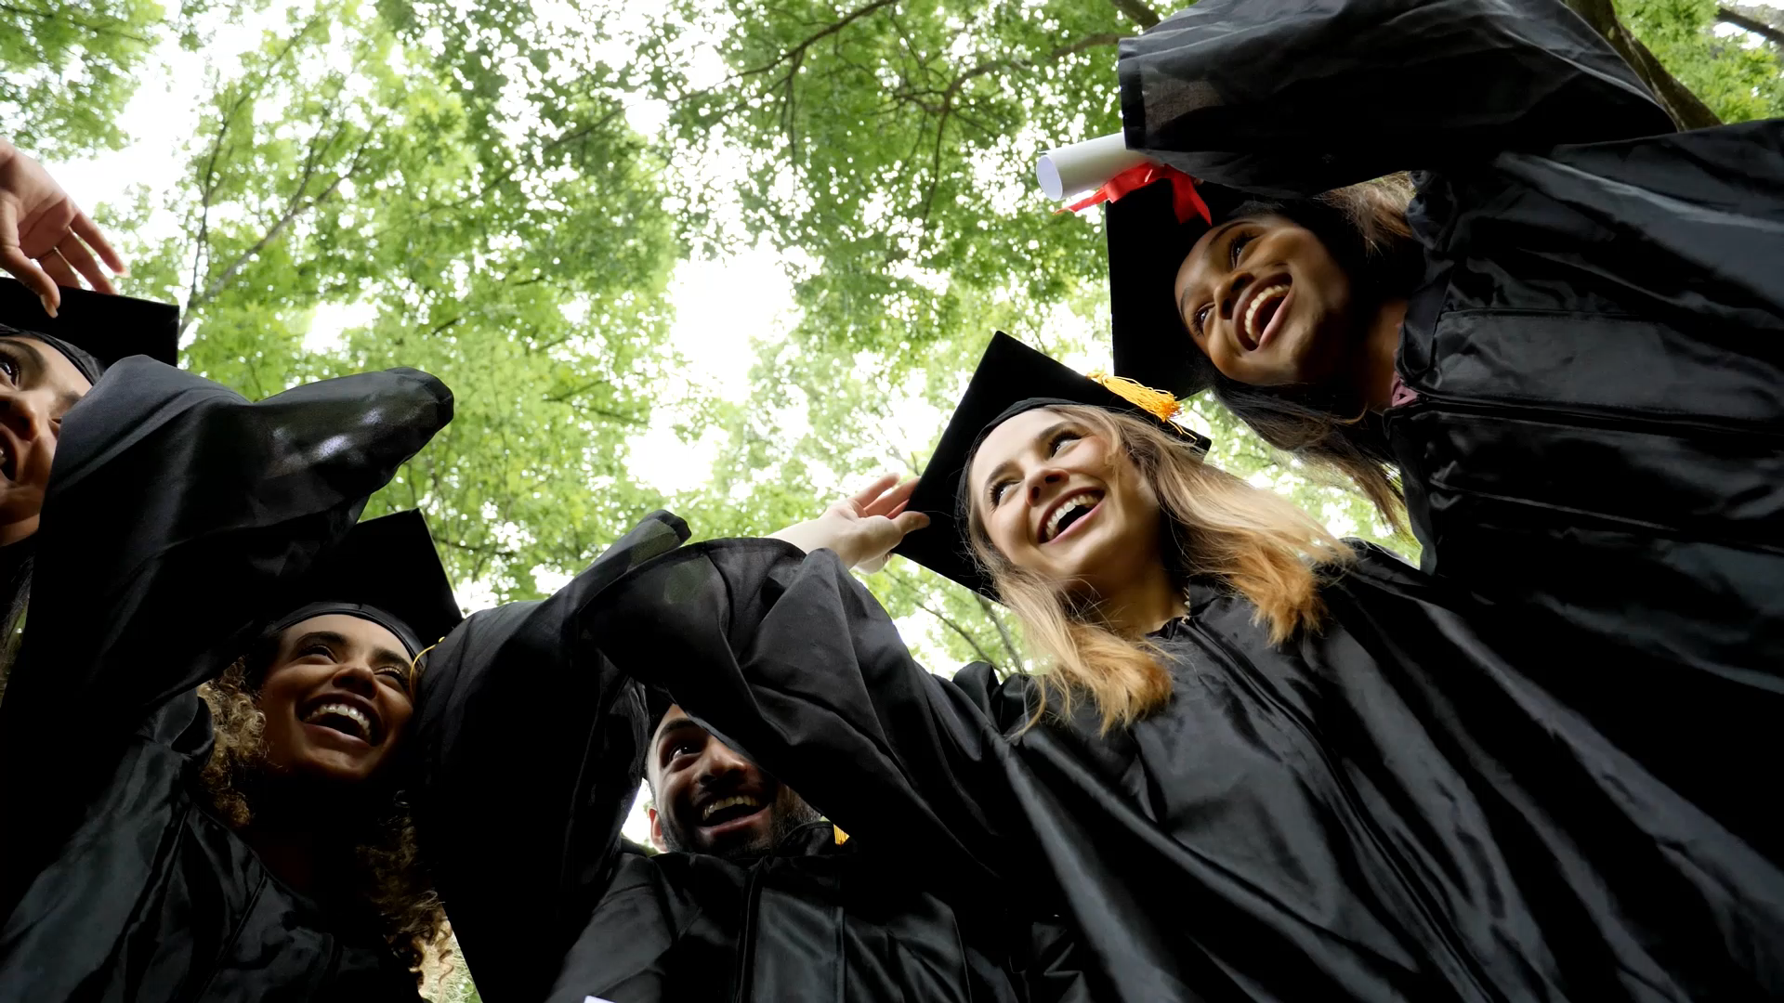
Admission Predictor: Unlocking Your Higher Education Journey

Slide 2

Team Members
Jalpa Tank
Megha Chaudhary
Rahil Pancholi
Siddharth Mahidhar

Slide 3
Index
Problem Statement
Project Goal
Data
EDA and Insights
Next Steps
Future Scope

Slide 4
Problem Statement
The college application process is a crucial and often overwhelming phase for students seeking admission to higher education institutions. Students invest significant time and effort into completing applications, writing essays, and preparing for standardized tests. However, the uncertainty surrounding college acceptance decisions can cause anxiety and hinder students' ability to make informed choices.
The problem at hand is the lack of a reliable and accessible tool that can accurately predict a student's likelihood of being accepted into specific colleges or universities. Existing acceptance rate data alone does not provide a comprehensive picture, as each institution considers a variety of factors, such as GPA, test scores, extracurricular activities, and recommendation letters, when evaluating applicants. Therefore, there is a need for a data-driven solution that can leverage historical admissions data and incorporate multiple variables to generate accurate predictions.

Slide 5

Project Goal
The goal of this project is to develop a machine learning model that can effectively predict the chances of admission for students applying to colleges and universities. By analyzing various factors such as academic performance, language proficiency, study gap, and more, the aim is to provide international students with valuable insights and guidance in their college selection process. The project strives to empower students with accurate predictions to enhance their decision-making and increase their chances of securing admission into their desired educational institutions.

Slide 6
Factors Influencing Acceptance
The project aims to predict the chance of acceptance into colleges and universities for international students based on a range of factors such as High School GPA, language proficiency (TOEFL, IELTS Academic, PTE, Duolingo, Cambridge), study gap, and number of backlogs.
By analyzing these factors, the project seeks to develop a predictive model that can accurately estimate the probability of acceptance for each student.

Slide 7

Datasets
Collected data through data scraping from various Ontario universities and colleges.
Algonquin College
Fanshawe College
St. Clair College
Niagara College
George Brown College
Conestoga College
University of Waterloo.

Slide 8
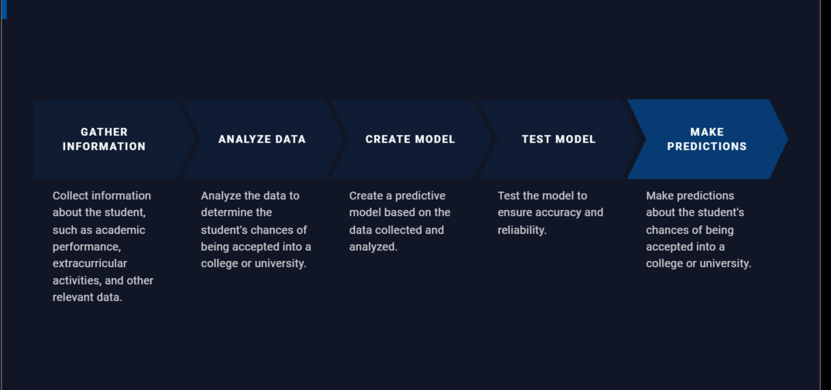

Slide 9
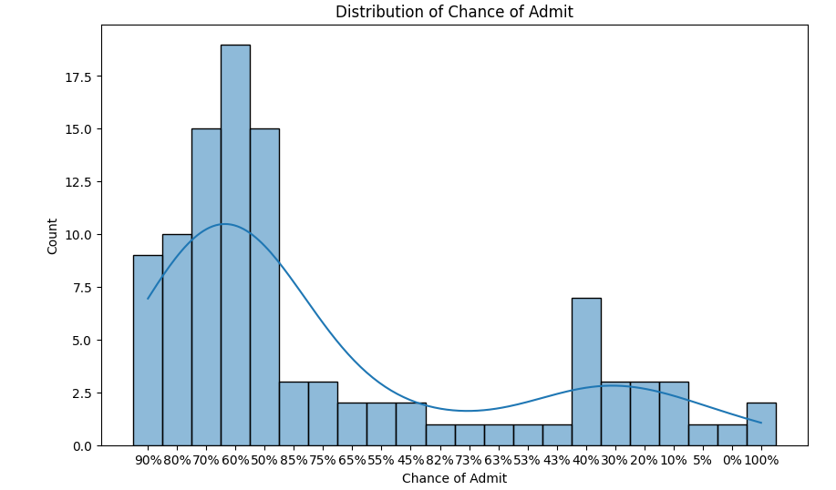
EDA AND PREPROCESSING

Slide 10
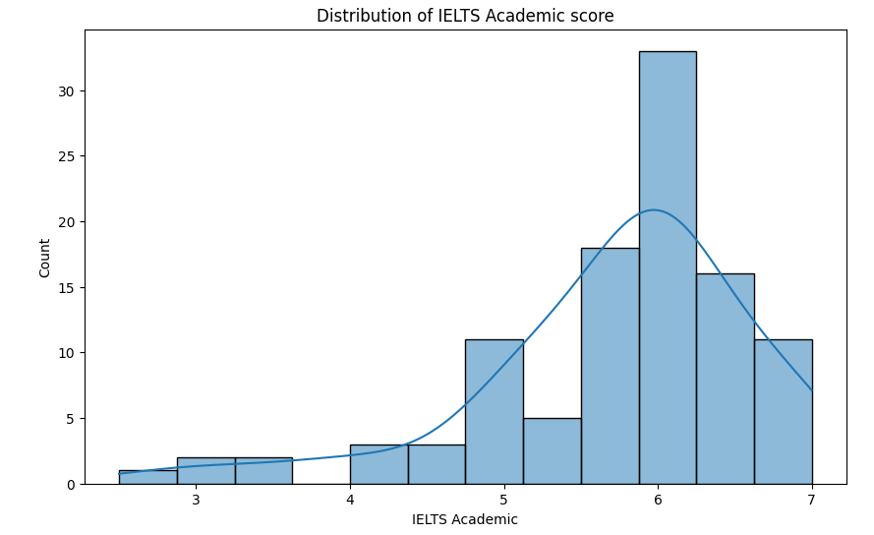

Slide 11
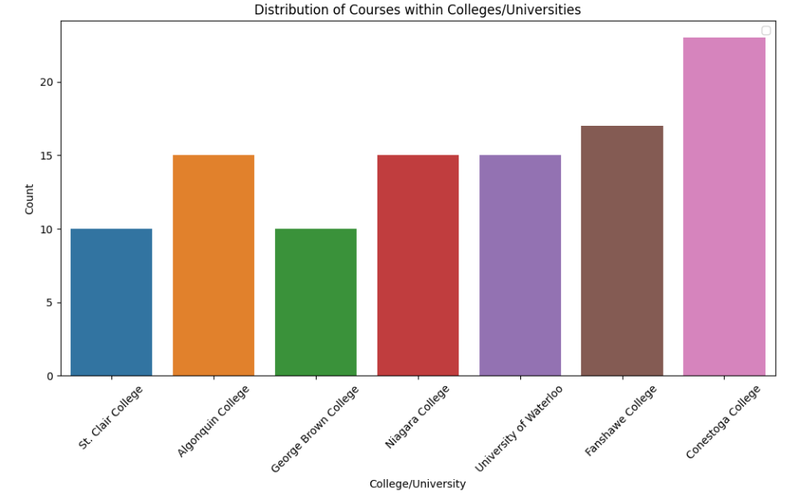

Slide 12
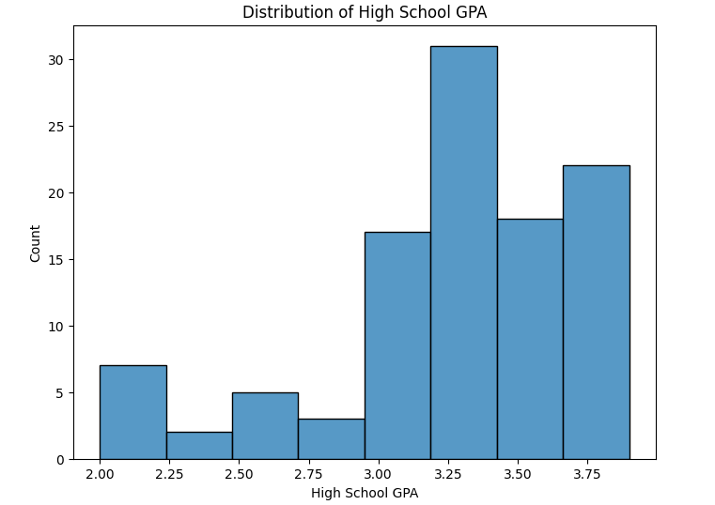

Slide 13
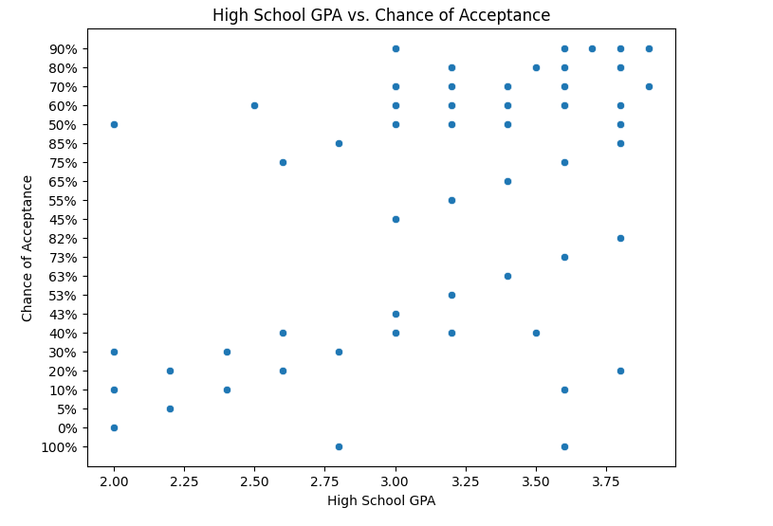

Slide 14
Model Development and Result
Linear Regression
Split into training and testing sets, with a test size of 20% and training 80%
Performance metrics used for evaluation are Mean Squared Error (MSE), Mean Absolute Error (MAE), and R-squared score.
Mean Squared Error: 345.81108
Mean Absolute Error: 13.65897
R-squared Score: 0.41981

Slide 15
Next Steps
Conduct further feature engineering and selection to improve the model's performance.
Explore different machine learning algorithms, such as Random Forest, to compare and enhance predictive capabilities.
Collect more data or expand the dataset to include a broader range of colleges and universities.

Slide 16
Thank You

